Slide 1
Virtual Reality & Augmented Reality Earth
https://leesander1.github.io/arvr/
https://leesander1.github.io/arvr/space.html

Slide 2
Project Introduction
An example using techniques learned in class to create objects in augmented reality and compatible with virtual reality devices. All in the browser. Use Chrome or else...
Technology used:
webvr
a-frame
av.js
Three.js

Slide 3
Course Material Covered
Interaction
Geometric Objects
Transformations
Projections
Modeling hierarchy
Scene graphs
OpenGL and Touch Screens
Clipping
Z-buffers
Lighting
Shading
Discrete texture mapping
Surfaces
Advanced rendering

Slide 4

Marker
The marker is used to set position of 3d space on top of camera layer. Different markers can be used... and the angle of the marker will change the 3d space.
For simplicity I am using the default marker.

Slide 5
https://leesander1.github.io/arvr/

Slide 6
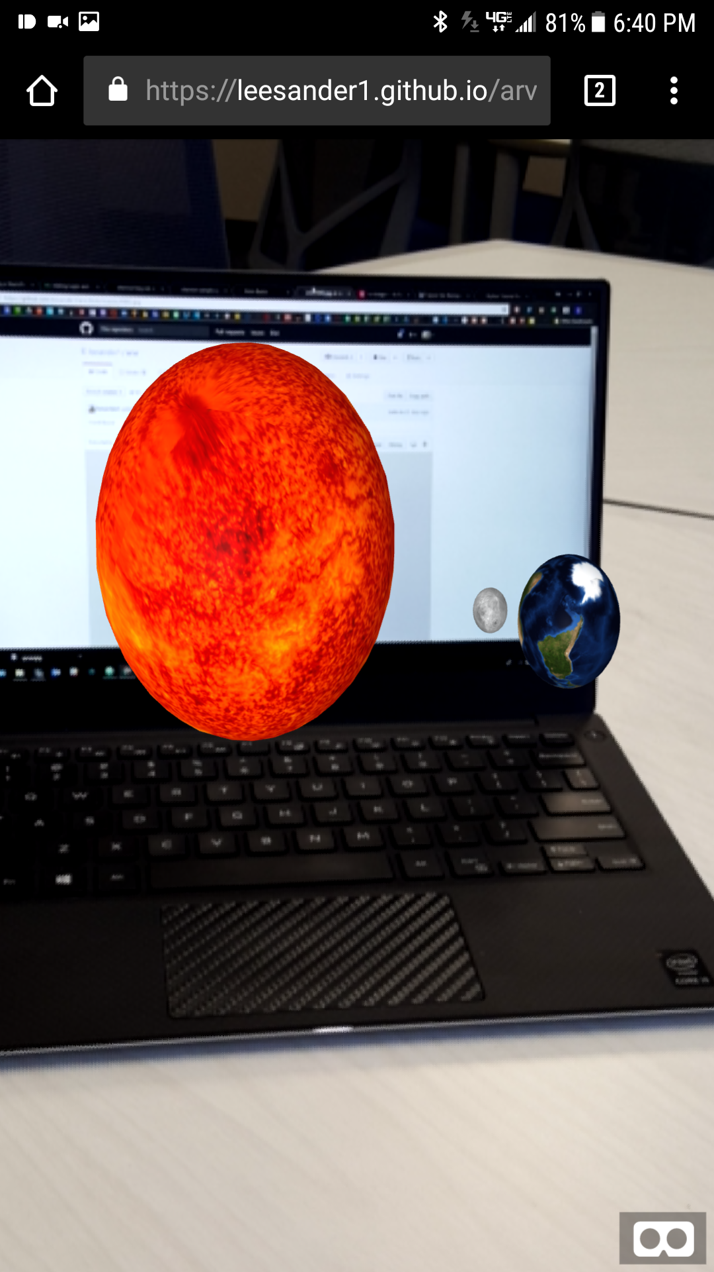
You should see
Something like this
Augmented sun, earth, moon projected on screen in 3d space of camera.

Slide 7
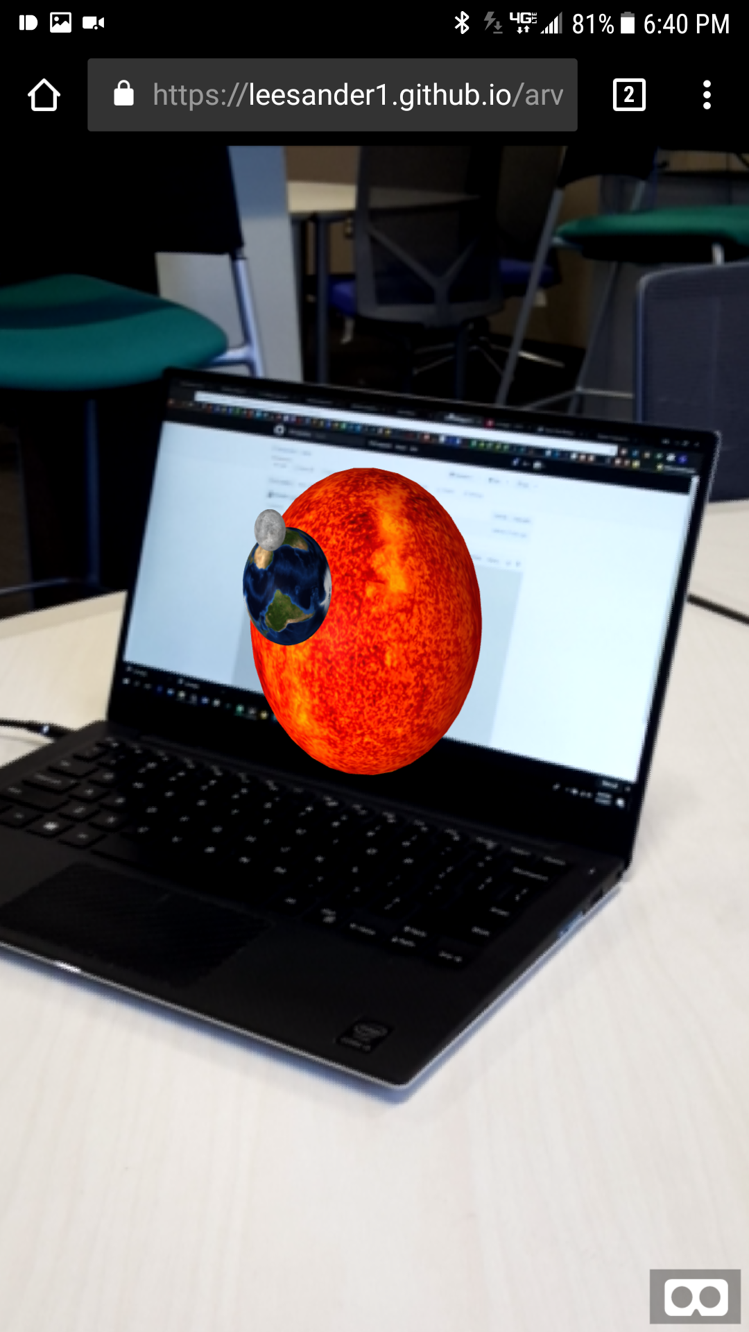
Click the VR button to go to VR mode
Built in support for VR headsets using webvr.

Slide 8
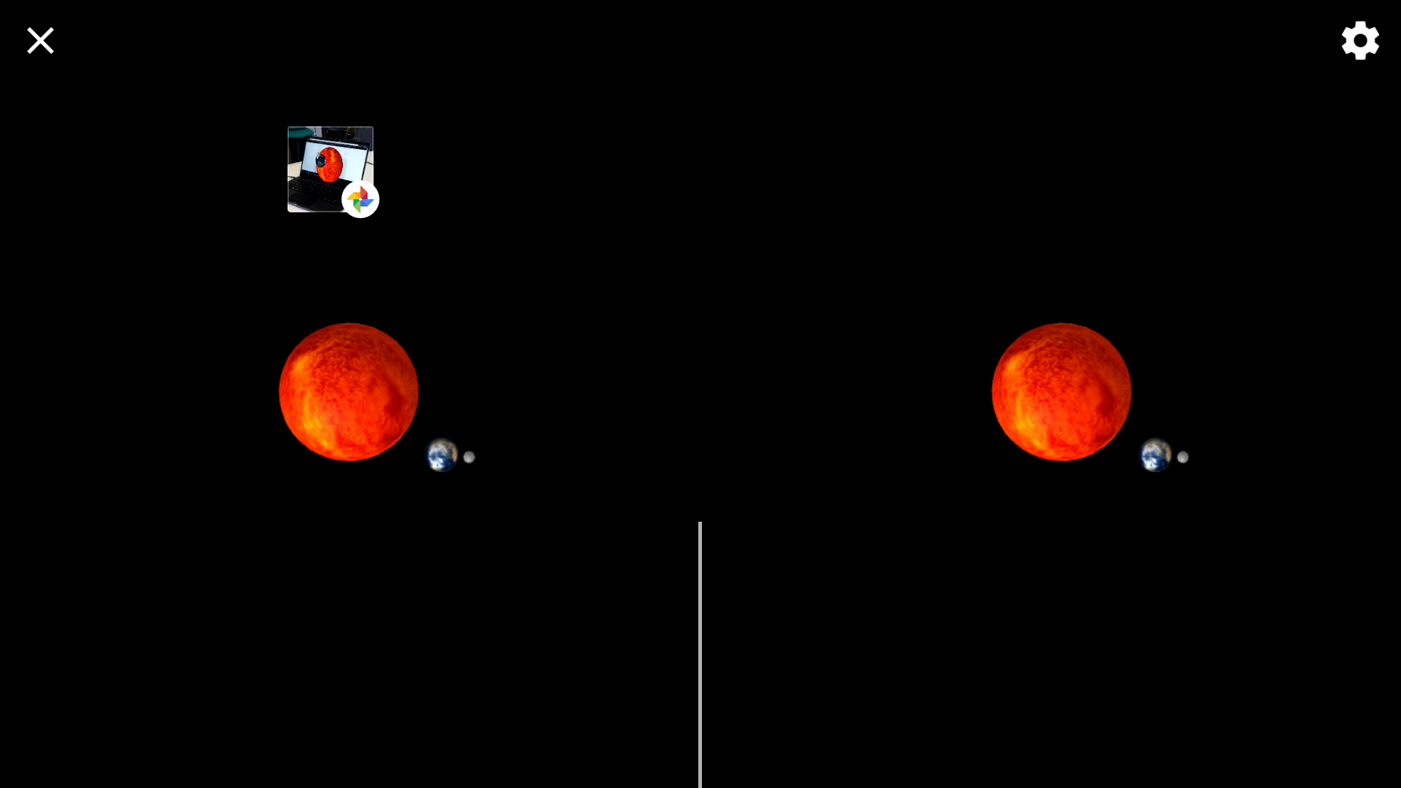

Slide 9
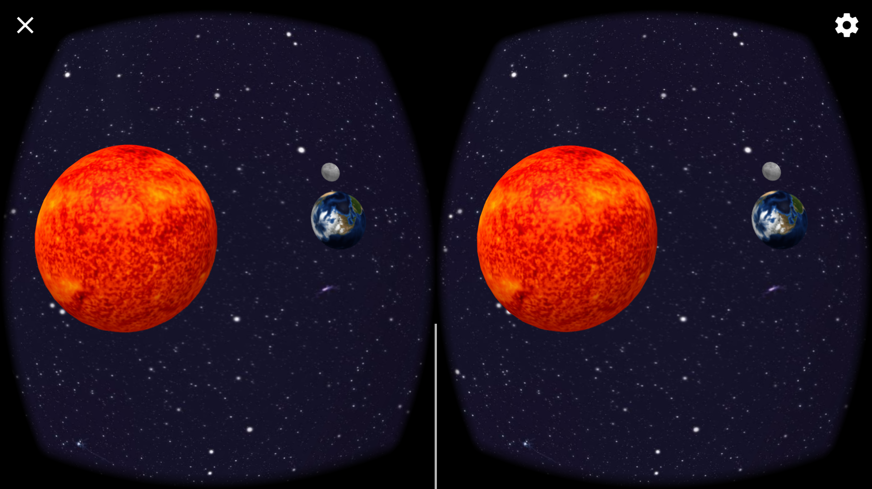
https://leesander1.github.io/arvr/space.html

Slide 10
Interaction
The interaction in this project is derived from several core features of the webvr concepts.
Cell phone camera used as background layer for 3d space
Marker used to initiate the AR objects
Can use vr headset to view 3d space

Slide 11
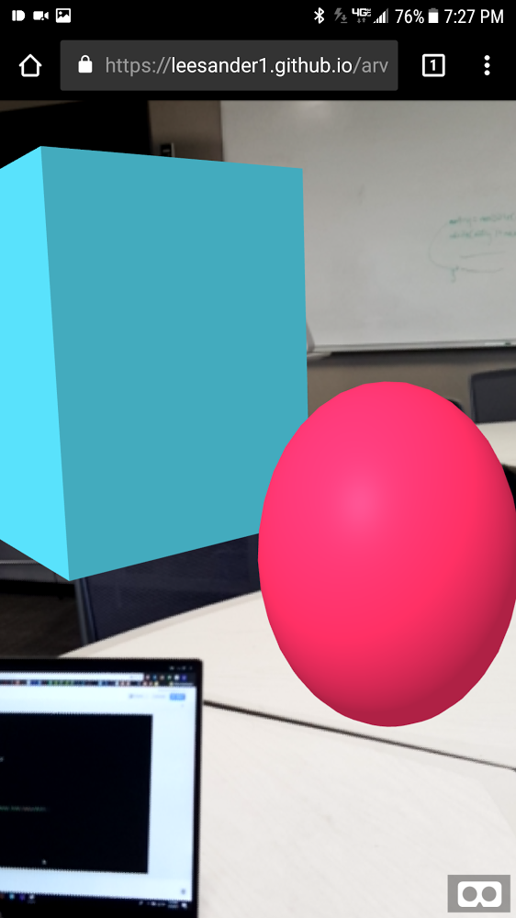
Geometric Objects
The objects used in the main part of project are all spheres. Another html file shapes.html uses other objects.
Rendered using a-frame library
<a-sphere></a-sphere>
Take a radius, src, position & more
https://leesander1.github.io/arvr/shapes.html

Slide 12
Shading
The objects used in the project are shaded. Effects like opacity are also available.

Slide 13
Transformations
The transformations implemented in this project are rotations around other objects.
Earth rotates around the sun’s z-axis at a set speed.
Moon rotates around earth’s z-axis at different speed

Slide 14
Projection & Z-Buffer
The objects use z-buffer to produce realistic physics of 3d environment
As the moon rotates, it disappears behind the earth object
As the earth rotates around the sun it disappears behind the sun
Also same for in front of objects

Slide 15
Clipping
The objects will render in space based on the position relative to the camera. Objects can collide.

Slide 16
Lighting
The scene lighting is rendered from the camera.

Slide 17
Texture Mapping
The objects have img textures that wrap the objects to give them realistic surfaces.

Slide 18
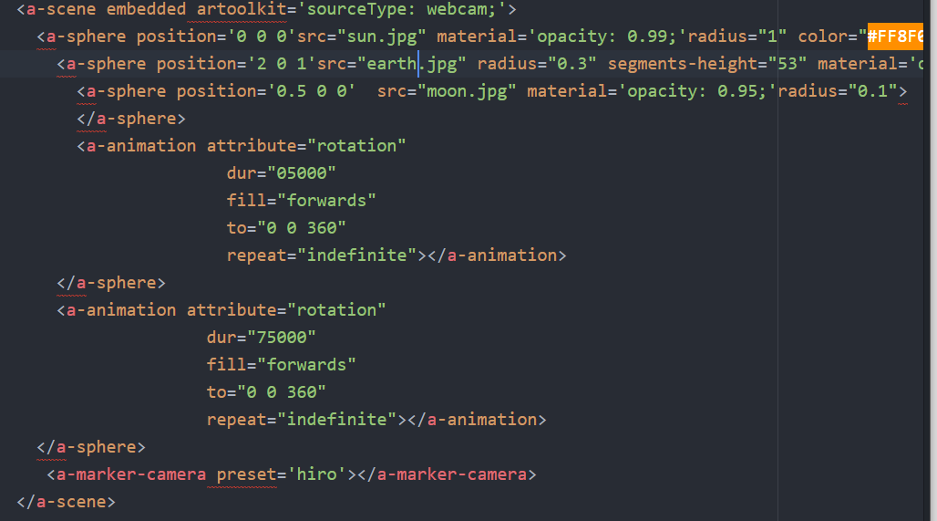
Modelling Hierarchy
There is a hierarchy for which all the objects exist in the scene.

Slide 19
Thanks!
Lee Sander
lee@leesander.com
Github: leesander1

